Slide 1
Servlet can be described in many ways, depending on the context.
Servlet is a technology which is used to create a web application.
Servlet is an API that provides many interfaces and classes including documentation.
Servlet is an interface that must be implemented for creating any Servlet.
Servlet is a class that extends the capabilities of the servers and responds to the incoming requests. It can respond to any requests.
Servlet is a web component that is deployed on the server to create a dynamic web page.

Slide 2
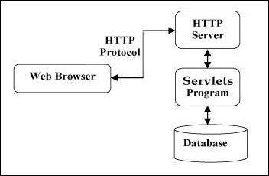
Servlets Architecture
The following diagram shows the position of Servlets in a Web Application.

Slide 3
Servlets can be created using the javax.servlet and javax.servlet.http packages, which are a standard part of the Java's enterprise edition, an expanded version of the Java class library that supports large-scale development projects.
The servlet can be created by three ways:
By implementing Servlet interface,
By inheriting GenericServlet class, (or)
By inheriting HttpServlet class

Slide 4
GenericServlet class
GenericServlet class implements Servlet, ServletConfig and Serializable interfaces. It provides the implementation of all the methods of these interfaces except the service method.
GenericServlet class can handle any type of request so it is protocol-independent.

Slide 5
import java.io.*;
import javax.servlet.*;
public class First extends GenericServlet{
public void service(ServletRequest req,ServletResponse res)
throws IOException,ServletException{
res.setContentType("text/html");
PrintWriter out=res.getWriter();
out.print("<html><body>");
out.print("<b>hello generic servlet</b>");
out.print("</body></html>");
}
}

Slide 6
HttpServlet class
The HttpServlet class extends the GenericServlet class and implements Serializable interface. It provides http specific methods such as doGet, doPost, doHead, doTrace etc.

Slide 7
import java.io.*;
import javax.servlet.*;
import javax.servlet.http.*;
// Extend HttpServlet class
public class HelloWorld extends HttpServlet {
private String message;
public void init() throws ServletException {
message = "Hello World"; } // Do required initialization
public void doGet(HttpServletRequest request, HttpServletResponse response)
throws ServletException, IOException {
// Set response content type
response.setContentType("text/html");
// Actual logic goes here.
PrintWriter out = response.getWriter();
out.println("<h1>" + message + "</h1>"); }
public void destroy() {
// do nothing. } }

Slide 8
The web container maintains the life cycle of a servlet instance. Let's see the life cycle of the servlet:
Servlet class is loaded.
Servlet instance is created.
init method is invoked.
service method is invoked.
destroy method is invoked.

Slide 9
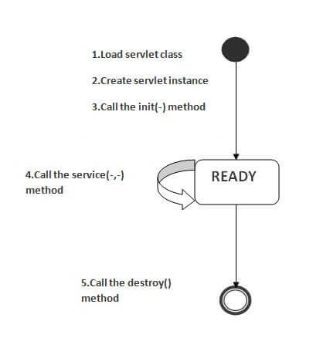
Life Cycle of a Servlet (Servlet Life Cycle)
Notes:
After servlet is garbage collected

Slide 10
As displayed in the above diagram, there are three states of a servlet: new, ready and end. The servlet is in new state if servlet instance is created. After invoking the init() method, Servlet comes in the ready state. In the ready state, servlet performs all the tasks. When the web container invokes the destroy() method, it shifts to the end state.
Refer:
https://javatpoint.com/life-cycle-of-a-servlet
Complete life cycle description

Slide 11
HTTP (Hyper Text Transfer Protocol)
The Hypertext Transfer Protocol (HTTP) is application-level protocol for collaborative, distributed, hypermedia information systems. It is the data communication protocol used to establish communication between client and server.
HTTP is TCP/IP based communication protocol, which is used to deliver the data like image files, query results, HTML files etc on the World Wide Web (WWW) with the default port is TCP 80. It provides the standardized way for computers to communicate with each other.

Slide 12
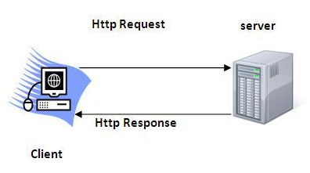

Slide 13
It is the protocol that allows web servers and browsers to exchange data over the web.
It is a request response protocol.
It uses the reliable TCP connections by default on TCP port 80.
It is stateless means each request is considered as the new request. In other words, server doesn't recognize the user by default.

Slide 14
Get vs. Post
GET | POST
1) In case of Get request, only limited amount of data can be sent because data is sent in header. | In case of post request, large amount of data can be sent because data is sent in body.
2) Get request is not secured because data is exposed in URL bar. | Post request is secured because data is not exposed in URL bar.
3) Get request can be bookmarked. | Post request cannot be bookmarked.
4) Get request is idempotent . It means second request will be ignored until response of first request is delivered | Post request is non-idempotent.
5) Get request is more efficient and used more than Post. | Post request is less efficient and used less than get.

Slide 15
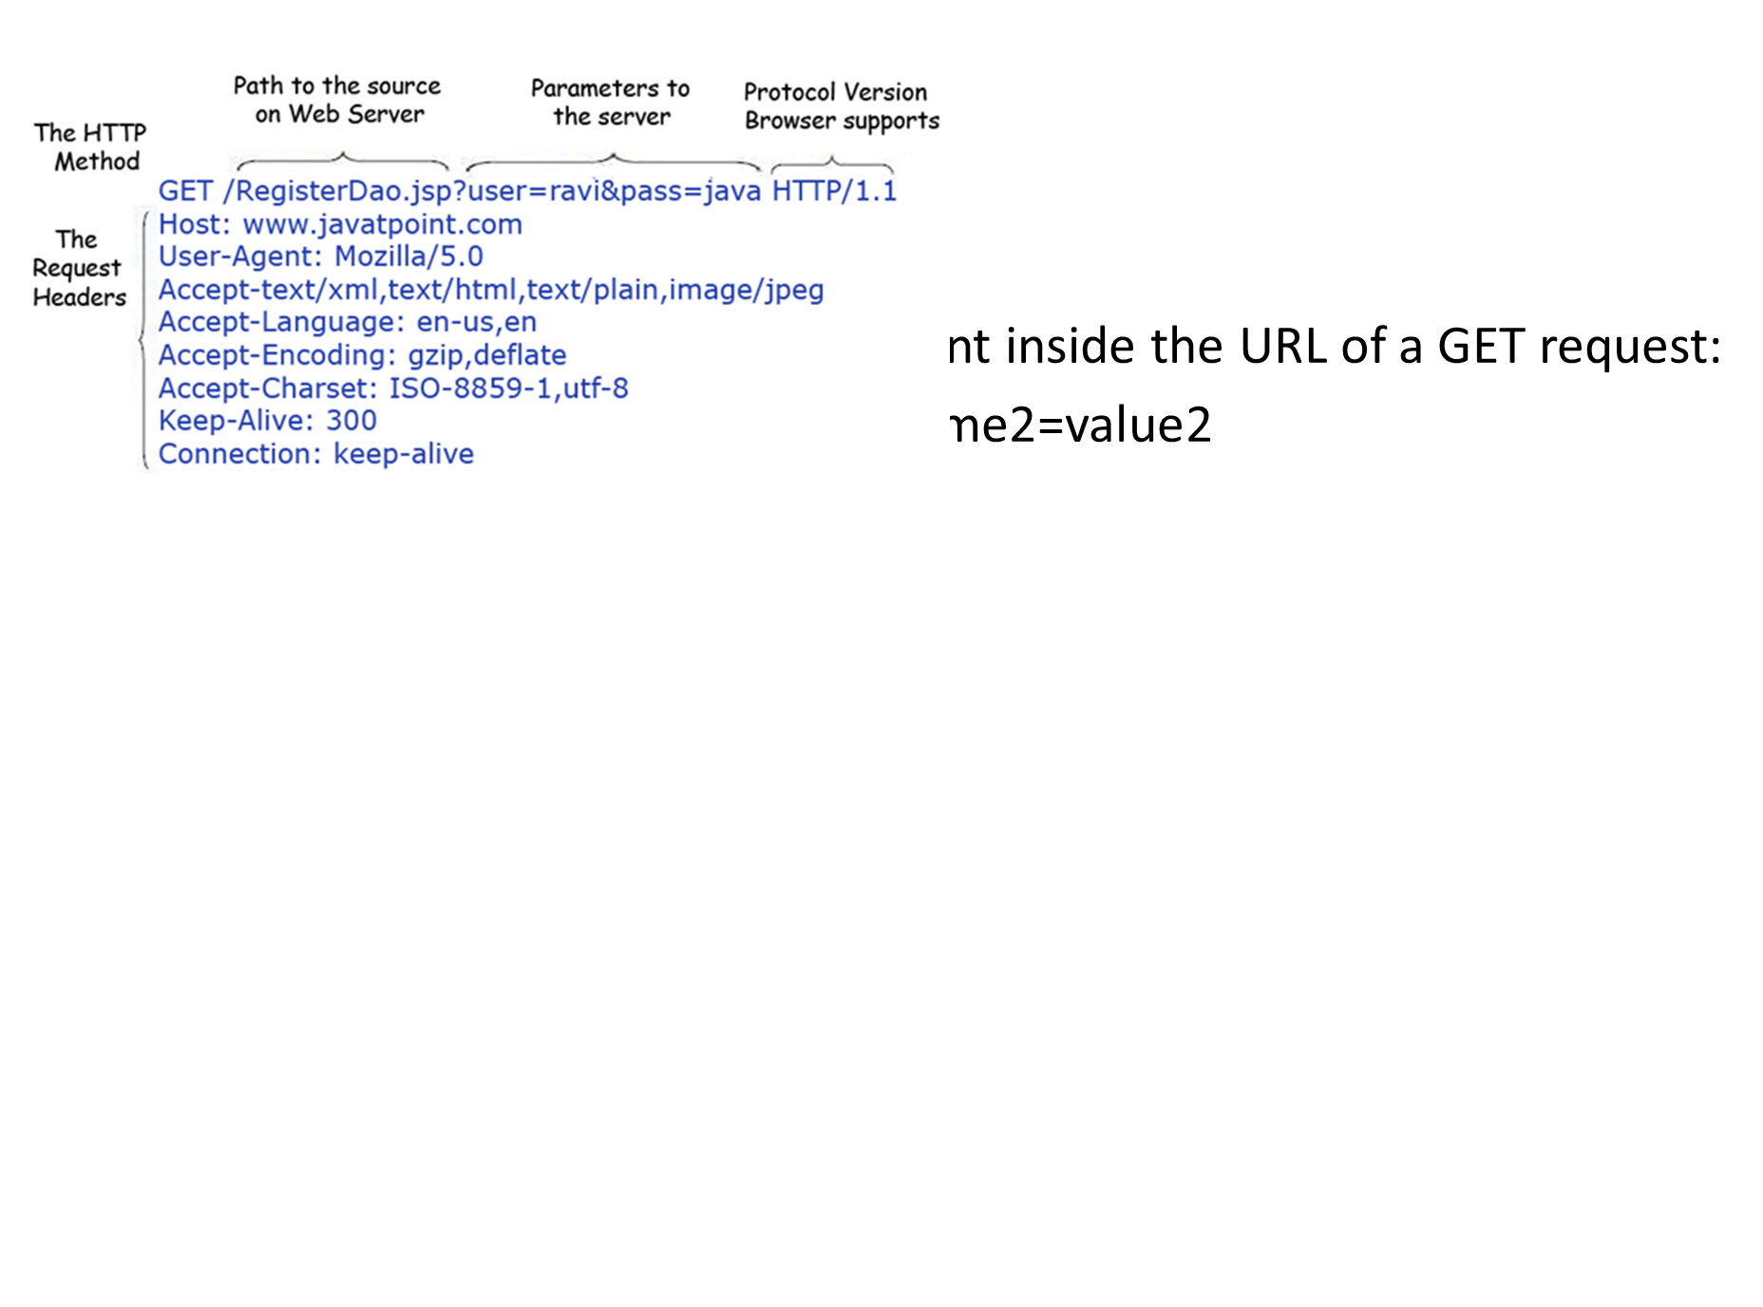
The query string (name/value pairs) is sent inside the URL of a GET request:
GET/RegisterDao.jsp?name1=value1&name2=value2

Slide 16
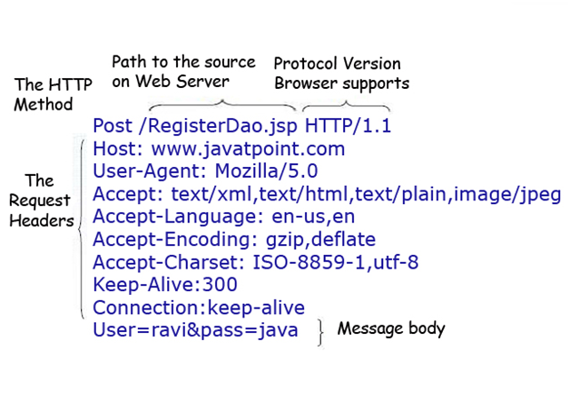
The query string (name/value pairs) is sent in HTTP message body for a POST request:
POST/RegisterDao.jsp HTTP/1.1
Host: www. javatpoint.com
name1=value1&name2=value2

Slide 17
ServletConfig Interface
An object of ServletConfig is created by the web container for each servlet. This object can be used to get configuration information from web.xml file.
If the configuration information is modified from the web.xml file, we don't need to change the servlet. So it is easier to manage the web application if any specific content is modified from time to time.
Methods of ServletConfig interface
public String getInitParameter(String name):Returns the parameter value for the specified parameter name.
public Enumeration getInitParameterNames():Returns an enumeration of all the initialization parameter names.
public String getServletName():Returns the name of the servlet.
public ServletContext getServletContext():Returns an object of ServletContext.

Slide 18
ServletContext Interface
An object of ServletContext is created by the web container at time of deploying the project. This object can be used to get configuration information from web.xml file. There is only one ServletContext object per web application.
If any information is shared to many servlet, it is better to provide it from the web.xml file using the <context-param> element.
Advantage of ServletContext
Easy to maintain if any information is shared to all the servlet, it is better to make it available for all the servlet. We provide this information from the web.xml file, so if the information is changed, we don't need to modify the servlet. Thus it removes maintenance problem.

Slide 19
There is given some commonly used methods of ServletContext interface.
public String getInitParameter(String name):Returns the parameter value for the specified parameter name.
public Enumeration getInitParameterNames():Returns the names of the context's initialization parameters.
public void setAttribute(String name,Object object):sets the given object in the application scope.
public Object getAttribute(String name):Returns the attribute for the specified name.
public Enumeration getInitParameterNames():Returns the names of the context's initialization parameters as an Enumeration of String objects.
public void removeAttribute(String name):Removes the attribute with the given name from the servlet context.

Slide 20
Difference between ServletConfig and ServletContext:
ServletConfig 1.ServletConfig available in javax.servlet.*; package 2.ServletConfig object is one per servlet class 3.destroyed once the servlet execution is completed. 4.We should give request explicitly, in order to create ServletConfig object for the first time 5.Object of ServletConfig will be created during initialization process of the servlet 6.This Config object is public to a particular servlet only ServletContext 1.ServletContext available in javax.servlet.*; package 2.ServletContext object is global to entire web application 3.Object of ServletContext will be created at the time of web application deployment 4.Scope: As long as web application is executing, ServletContext object will be available, and 5.it will be destroyed once the application is removed from the server. 6.ServletContext object will be available even before giving the first request

